Slide 1
Case Study 1 EDA and Initial Modeling
Unit 8 Project Preparation
Isabella Westlauer
3/1/2026

Slide 2
Goal: Compare Cost of Employee Incentive vs. Replacement by Analyzing Attrition Factors
Cost of incentives
Cost of replacement
Factors correlated with attrition
Employees Lost
Replacement cost: 50% - 400% of the employee’s annual salary
Employees Retained
Incentive cost: $200
Notes:
What is the cost of employee incentive, to retain employees?
What is the cost to replace employees who leave?
What factors lead to employees leaving?
What factors lead to employees staying?

Slide 3
What is attrition?
Losing employees to resignation, retirement, or death
Frito Lay’s attrition rate: 16%
For 140 employees
Incentives:
$28,000
Replacement: $10,735,644
Notes:
Almost 400 times as much to replace employees as to provide incentives

Slide 4
Summary of Categorical Features
Attrition | BusinessTravel | Department | EducationField | Gender | JobRole | MaritalStatus | Over18 | OverTime
No | Travel_Rarely | Sales | Life Sciences | Male | Sales Executive | Divorced | Y | No
Yes | Travel_Frequently | Research & Development | Medical | Female | Research Director | Single |  | Yes
 | Non-Travel | Human Resources | Marketing |  | Manufacturing Director | Married
 |  |  | Technical Degree |  | Research Scientist
 |  |  | Other |  | Sales Representative
 |  |  | Human Resources |  | Healthcare Representative
 |  |  |  |  | Manager
 |  |  |  |  | Human Resources
 |  |  |  |  | Laboratory Technician

Slide 5
Summary of Numerical Features
Variable | Mean | SD | Min | Median | Max | histogram
Age | 36.828736 | 8.9259504 | 18 | 35 | 60 | ▂▇▇▃▂
DailyRate | 815.227586 | 401.1162803 | 103 | 817.5 | 1499 | ▇▇▇▇▇
DistanceFromHome | 9.33908 | 8.1367039 | 1 | 7 | 29 | ▇▅▂▂▂
Education | 2.901149 | 1.0230366 | 1 | 3 | 5 | ▂▅▇▆▁
EnvironmentSatisfaction | 2.701149 | 1.0993768 | 1 | 3 | 4 | ▅▆▁▇▇
HourlyRate | 65.613793 | 20.1271629 | 30 | 66 | 100 | ▇▇▆▇▇
JobInvolvement | 2.722989 | 0.7036321 | 1 | 3 | 4 | ▁▃▁▇▁
JobLevel | 2.03908 | 1.0901121 | 1 | 2 | 5 | ▇▇▃▂▁
JobSatisfaction | 2.709195 | 1.1145168 | 1 | 3 | 4 | ▅▅▁▇▇
MonthlyIncome | 6390.264368 | 4597.695974 | 1081 | 4945.5 | 19999 | ▇▅▂▁▁
MonthlyRate | 14325.62069 | 7108.381928 | 2094 | 14074.5 | 26997 | ▇▇▇▇▇
NumCompaniesWorked | 2.727586 | 2.520443 | 0 | 2 | 9 | ▇▃▂▂▁
PercentSalaryHike | 15.2 | 3.6754402 | 11 | 14 | 25 | ▇▅▃▂▁
PerformanceRating | 3.151724 | 0.3589596 | 3 | 3 | 4 | ▇▁▁▁▂
RelationshipSatisfaction | 2.706897 | 1.1024915 | 1 | 3 | 4 | ▅▅▁▇▇
StockOptionLevel | 0.783908 | 0.857764 | 0 | 1 | 3 | ▇▇▁▂▁
TotalWorkingYears | 11.052874 | 7.5136675 | 0 | 10 | 40 | ▇▇▂▁▁
TrainingTimesLastYear | 2.832184 | 1.2726651 | 0 | 3 | 6 | ▂▇▇▂▃
WorkLifeBalance | 2.781609 | 0.7119769 | 1 | 3 | 4 | ▁▃▁▇▂
YearsAtCompany | 6.962069 | 6.021036 | 0 | 5 | 40 | ▇▃▁▁▁
YearsInCurrentRole | 4.204598 | 3.6393169 | 0 | 3 | 18 | ▇▃▂▁▁
YearsSinceLastPromotion | 2.168966 | 3.1858725 | 0 | 1 | 15 | ▇▁▁▁▁
YearsWithCurrManager | 4.14023 | 3.5744413 | 0 | 3 | 17 | ▇▂▅▁▁
High and Low distribution
ratings (1 to 5)
Right Skew distribution
most employees are on the low end and few employees are on the high end
ID, EmployeeCount, EmployeeNumber, and StandardHours were removed.
Notes:
Using the skimr library to get a quick look at the numerical variables, I can quickly spot some irrelevant variables: ID, EmployeeNumber, StandardHours.
Hourly Rate and Monthly Rate are unclear?
I also noted that there were no missing values in the dataset.
At first glance, some variables I want to take a closer look at: YearsInCurrentRole, NumCompaniesWorked, Education, JobLevel, MonthlyIncome, JobSatisfaction, TotalWorkingYears,

Slide 6
Summary of Numerical Features
Variable | Histogram
Age | ▂▇▇▃▂
Education | ▂▅▇▆▁
EnvironmentSatisfaction | ▅▆▁▇▇
JobInvolvement | ▁▃▁▇▁
JobSatisfaction | ▅▅▁▇▇
RelationshipSatisfaction | ▅▅▁▇▇
WorkLifeBalance | ▁▃▁▇▂
StockOptionLevel | ▇▇▁▂▁
DistanceFromHome | ▇▅▂▂▂
JobLevel | ▇▇▃▂▁
MonthlyIncome | ▇▅▂▁▁
NumCompaniesWorked | ▇▃▂▂▁
PercentSalaryHike | ▇▅▃▂▁
TotalWorkingYears | ▇▇▂▁▁
YearsAtCompany | ▇▃▁▁▁
YearsInCurrentRole | ▇▃▂▁▁
YearsSinceLastPromotion | ▇▁▁▁▁
YearsWithCurrManager | ▇▂▅▁▁
High and Low distribution
ratings (1 to 5)
Right Skew distribution
most employees are on the low end and few employees are on the high end
ID, EmployeeCount, EmployeeNumber, HourlyRate, DailyRate, MonthlyRate and StandardHours are not useful.
Years variables look similar in distribution.
Notes:
Using the skimr library to get a quick look at the numerical variables, I can quickly spot some irrelevant variables: ID, EmployeeNumber, StandardHours.
Hourly Rate and Monthly Rate are unclear?
I also noted that there were no missing values in the dataset.
At first glance, some variables I want to take a closer look at: YearsInCurrentRole, NumCompaniesWorked, Education, JobLevel, MonthlyIncome, JobSatisfaction, TotalWorkingYears,

Slide 7
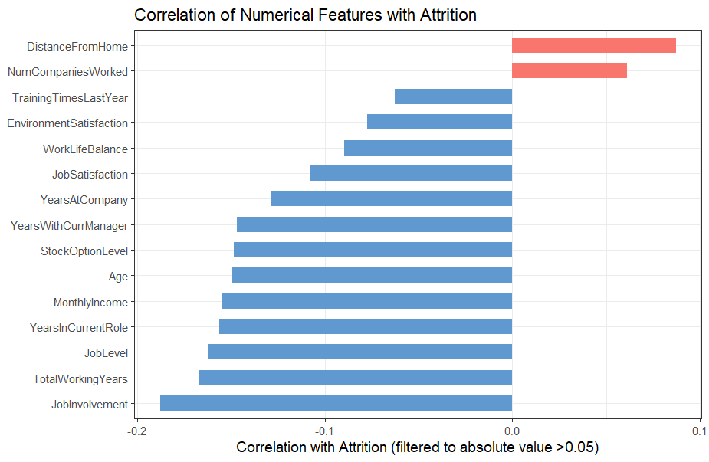

Slide 8
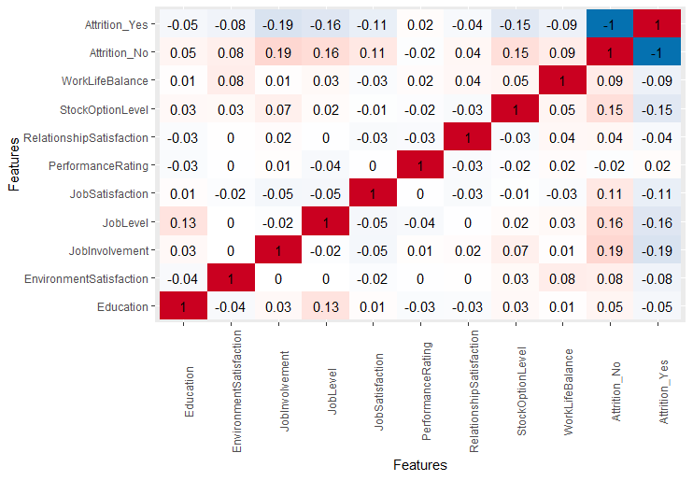
Correlation Heatmaps
Stock Option
Level
Job Satisfaction
Job Level
Job Involvement

Slide 9
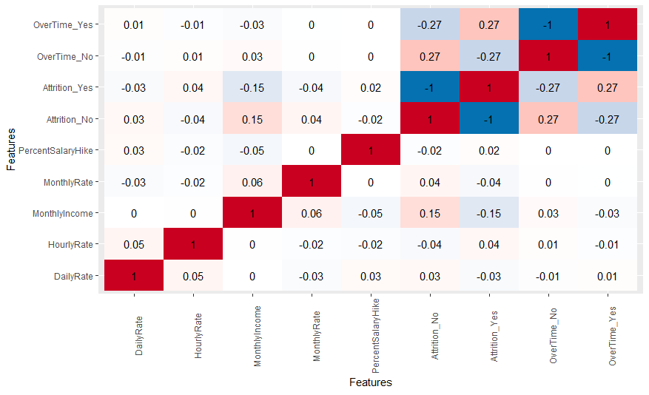
Correlation Heatmaps
Over Time
Monthly
Income

Slide 10
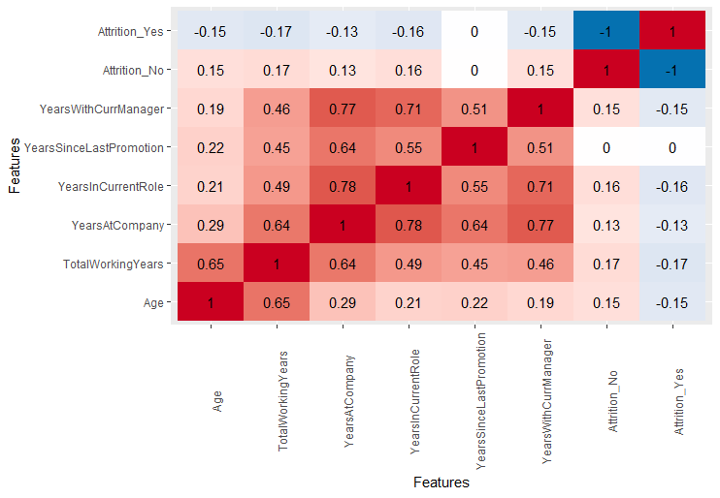
Correlation Heatmaps
Years…
With Current Manager
In Current Role
At Company
Total in Workforce
Age
Notes:
These features measured in years are well correlated because for example, the older an employee, the longer he or she may have been working. The longer an employee has been working, the longer with the company. The longer an employee is with the company, the longer they may have been in their current role or with their current manager.

Slide 11
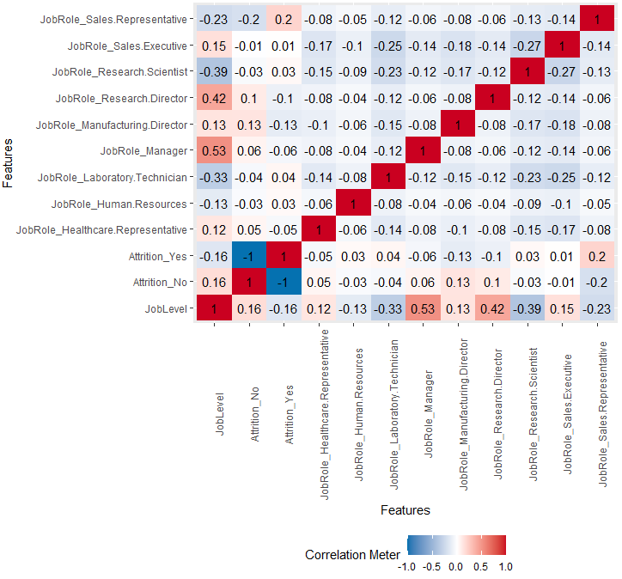
Correlation Heatmaps
Sales Representative
Research Director
Manufacturing Director
Job Level
Notes:
Note that the research director and manager have a high correlation with Job Level..

Slide 12
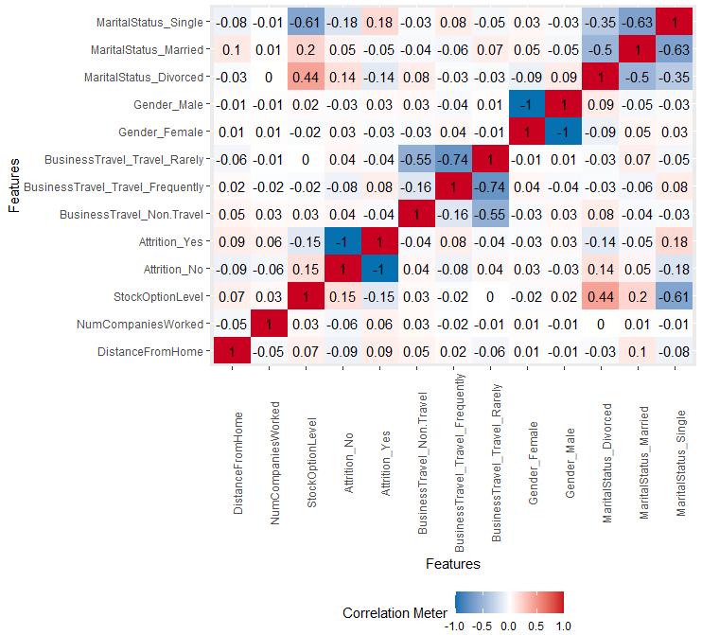
Correlation Heatmaps
Marital Status
Stock Option Level

Slide 13
Variables of Interest Based on Correlation Heatmaps
Variables of Interest | Correlation with Attrition
OverTime | Positive | 0.27
JobRole_Sales Representative | Positive | 0.20
MaritalStatus_Single | Positive | 0.18
JobInvolvement | Negative | 0.19
TotalWorkingYears | Negative | 0.17
JobLevel | Negative | 0.16
YearsInCurrentRole | Negative | 0.16
YearsWithCurrManager | Negative | 0.15
StockOptionLevel | Negative | 0.15
MonthlyIncome | Negative | 0.15
Age | Negative | 0.15
MaritalStatus_Divorced | Negative | 0.14
Years at Company | Negative | 0.13
JobRole_Manufacturing Director | Negative | 0.13
These variables have relatively high correlation with each other.
Notes:
Many of the “year variables” are strongly correlated with each other.
We may need to select one or combine one or more into a derived feature.
I wonder if a derived feature could have a stronger correlation with attrition than these do.
Should I focus only one the ones with the greatest positive correlation with attrition????

Slide 14
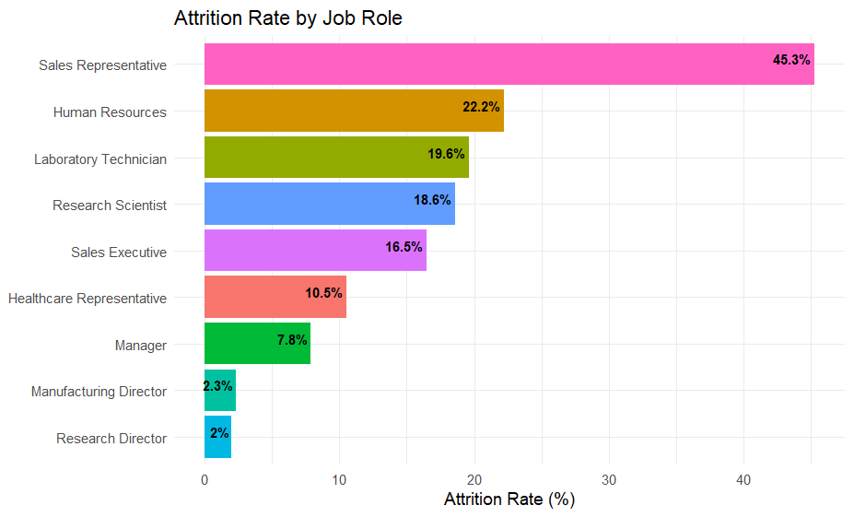
Notes:
The point of this slide is that you see a lot more attrition in the sales reps and hr roles, but those only make a small percent of all the employees. (Over half of those who left made up less than 10% of all employees- in the job roles of sales rep and HR.) but, Most of the employees are in the job roles of sales exec, research scientist, and lab tech – making up over half of those who left.

Slide 15
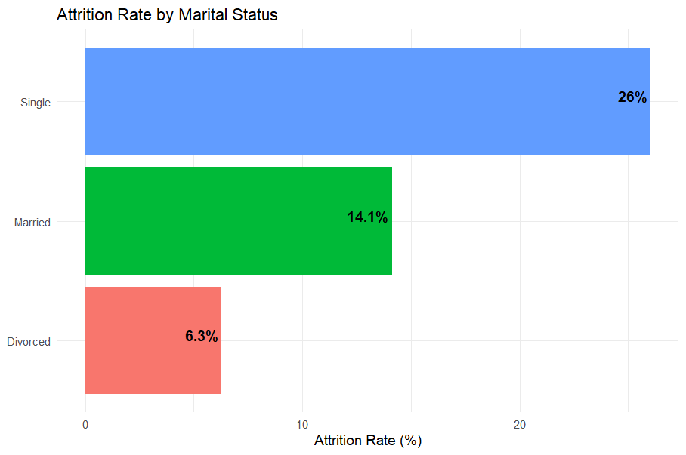

Slide 16
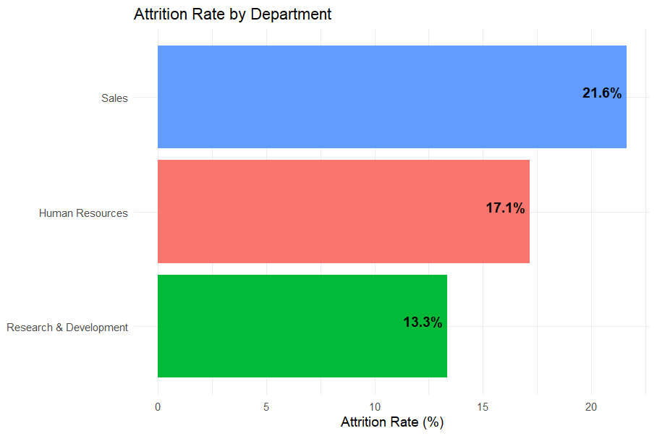

Slide 17
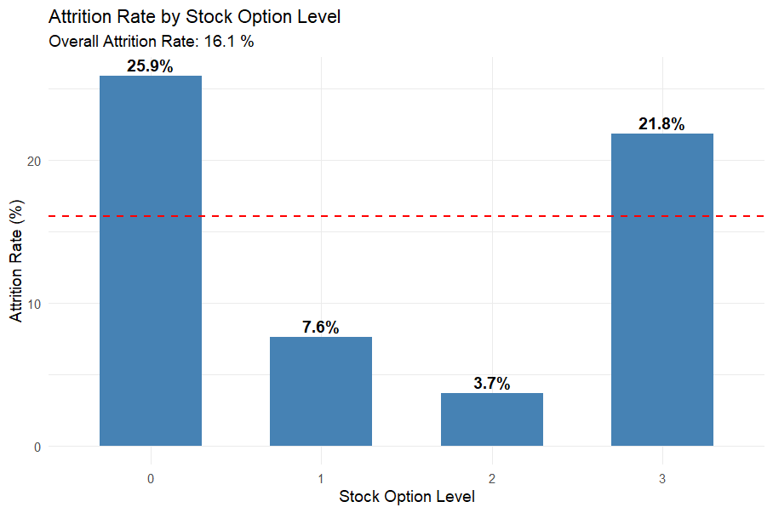
Notes:
44 percent of the employees have a stock option level 0, and over 25% of those who left had a stock option level of 0. However, over 20% of those who left had a stock option level 3.. And only 6% of your employees have a stock option level 3. So why is it that those employees are leaving?

Slide 18
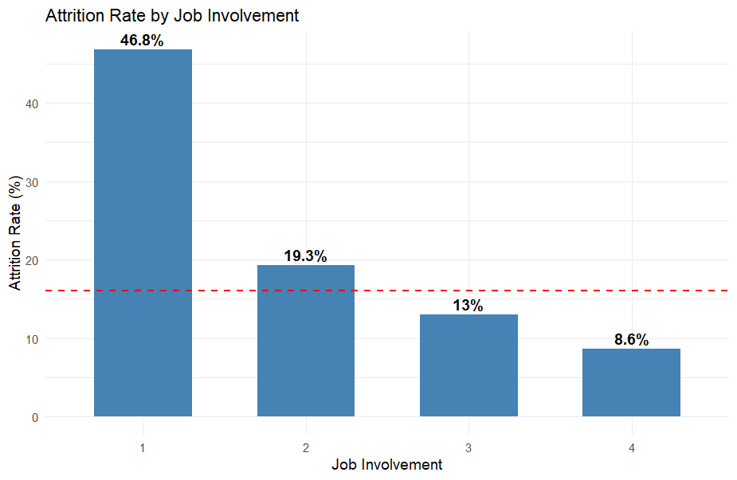

Slide 19
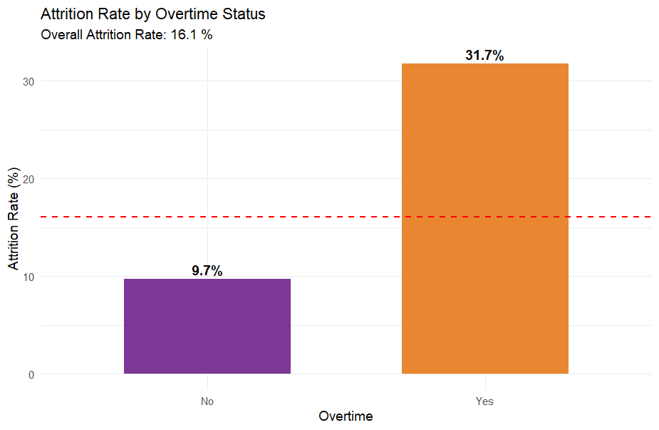

Slide 20
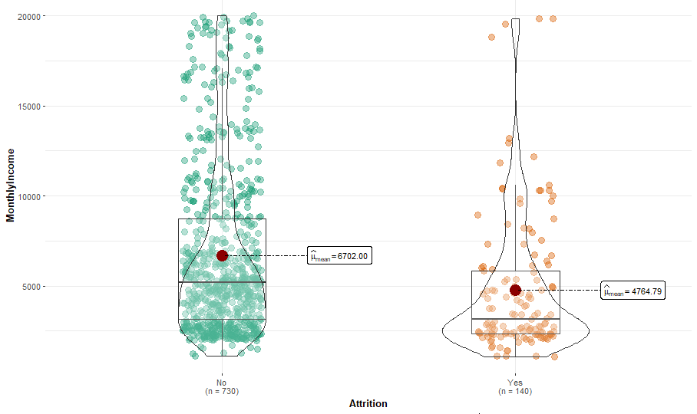
Attrition by Monthly Income

Slide 21
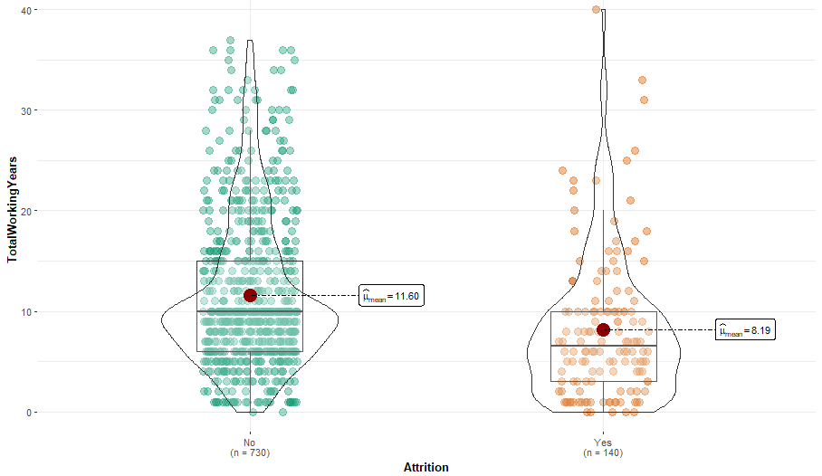
Attrition by Total Working Years

Slide 22
Initial Selected Features for Classification
OverTime
MonthlyIncome
MonthlyIncome_quartile
MaritalStatus = Single
StockOptionLevel
Notes:
I need to train classification models on numeric predictors, so if there are any features for classification I should find the numeric feature that is most closely related. Is marital status related to age?
Can I just change overtime to a 0 and 1?

Slide 23
Comparison of Initial Models
Model | Predictors | Accuracy | Sensitivity | Specificity
KNN | MaritalStatus_Single, OverTime_Num | 88.51% | 96.51% | 31.25%
Naïve Bayes 1 | MaritalStatus_Single, OverTime_Num | 88.51% | 96.51% | 31.25%
Naïve Bayes 2 | MonthlyIncome_quartile, OverTime_Num | 85.44% | 95.41% | 34.88%
Naïve Bayes 3 Threshold for a Yes = 0.2 | MonthlyIncome_quartile, OverTime_Num | 78.16% | 81.65% | 60.47%
A model with higher specificity is better at classifying Attrition = yes

Slide 24
Reference Notes
Studies also show that the cost of losing an employee depends upon their position.
An entry-level employee turnover cost is between 30% and 50% of their annual salary to replace.
A mid-level employee turnover costs between 125% and 150% of their annual salary to replace.
A high-level or highly specialized employee costs approximately 400% of their annual salary to replace.
Frito Lay says it costs between 50% and 400% of the employee’s salary to replace.
Key strategy # 1: Don’t wait until turnover costs become unacceptably high before you implement an ongoing retention program. Put a retention program in place before you have crisis situation. You not only must find out why employees leave your organization, you must also find out why others stay.
What causes attrition = yes, and what causes attrition = no?
https://www.merriam-webster.com/dictionary/attrition

